Slide 1
Year 10 Science
Investigating: Planning

Slide 2

Review: IDC
Do ice vests improve footy players recovery?

Slide 3

Review: IDC
Do kids who eat breakfast do better at school?

Slide 4
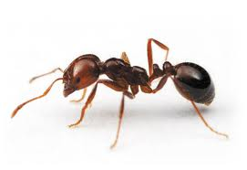
Review: Write a hypothesis
Are ants more active in hot weather?

Slide 5
Learning Intention
Consider type of data for planning investigations

Slide 6
Success criteria
Classify data as non-numerical or numerical; discrete grouped or continuous
Give examples of each
Select the appropriate type of graph for each
Explain why continuous data is most useful

Slide 7
Types of independent variables
Numerical vs. non-numerical
Continuous, discrete or grouped
This affects the type of hypothesis and the type of graph
The type of graph determines what you can use it for

Slide 8
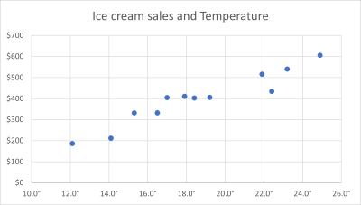
Why is continuous numerical data best?
Line graphs
Interpolation
Extrapolation

Slide 9
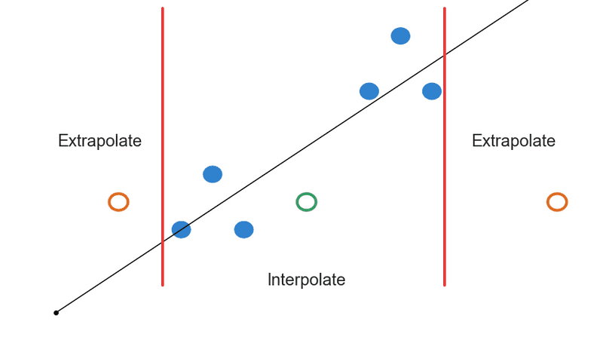


Slide 10
Success criteria
Classify data as non-numerical or numerical; discrete grouped or continuous
Give examples of each
Select the appropriate type of graph for each
Explain why continuous data is most useful

